Slide 1
Reimbursement Request Form (RRF) Basics
[Ver 1.0] 05.08.2025
External

Slide 2
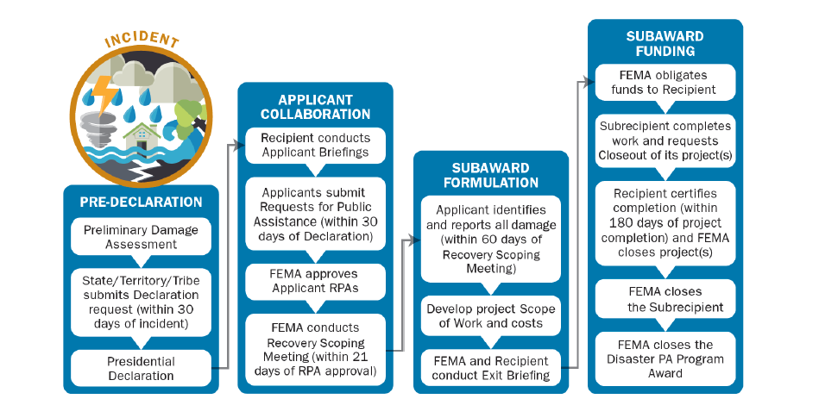

Lifecycle of a Disaster
Grants Management
Notes:
Identify three main stakeholders when going over snake chart: FEMA, State, Applicant

Slide 3
What Next?
FEMA writes and obligates the Project Worksheet (PW) in their website, Grants Portal
The PW is synced into GOHSEP’s website, LouisianaPA.com (LAPA)
When a new PW or PW version is synced into LAPA, it undergoes a Package Review by GOHSEP
Completion of the Package review makes funds available for reimbursement in LAPA
The size of the PW will determine what payment trigger will be needed for the Applicant to receive their reimbursement

Slide 4
Payment Triggers
Project size is typically determined by FEMA’s Large Project Threshold in effect on date of disaster declaration
Small Projects
Automatic payment upon approval of Package Review
Some Small Projects will require the Applicant to submit Small Project Advances
Large Projects
The Applicant will submit RRFs in order to request funds
Express Payment (Documented Advance)
Detailed Review Payment
Undocumented Advance (very rare)

Slide 5
What is LouisianaPA.com (LAPA)?
By definition:
“This site is for the online application and management of the Public Assistance (PA) grant.”
LAPA is where GOHSEP does all of our work…
It’s where information about an Applicant’s accounts, such as their Disaster accounts, their projects, their expenses, their payments, their Quarterly Reports, etc. is maintained
This is where Applicants will submit their RRFs
Notes:
Mention Grants Portal and EMMIE, namely that they do not communicate or automatically move any documents over into LAPA

Slide 6
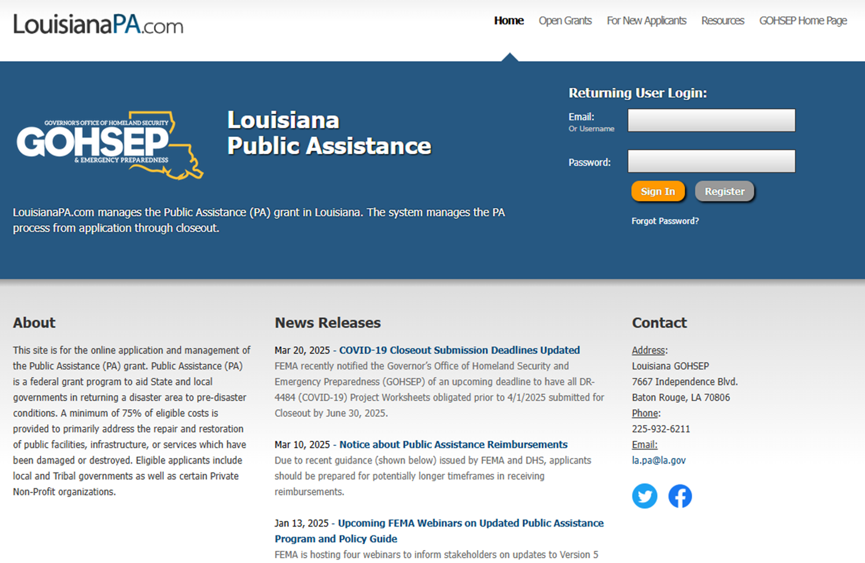

Slide 7
What is an “RRF”?
The Applicant (Sub-grantee) submits a package which notifies the State (Grantee, GOHSEP) that they would like to draw down on funds obligated by FEMA for PA recovery projects.
The Reimbursement Request Form (“RRF”) begins the process of reimbursement to the Applicant.
Supporting documentation (such as bids, contracts, invoices, etc.) must be submitted with the RRF.

Slide 8
RRF Resources
RRF Submission Guide
LAPA → Resources → PA Toolbox → Grants Management → RRF Training Packet for Applicants Updated Sept 2023
Applicants can also refer to the Public Assistance Program and Policy Guide (PAPPG) in effect on date of Disaster Declaration
Can find on any search engine
Located in LAPA: LAPA→ Resources → Disaster Specific Info → Linked in each Disaster

Slide 9
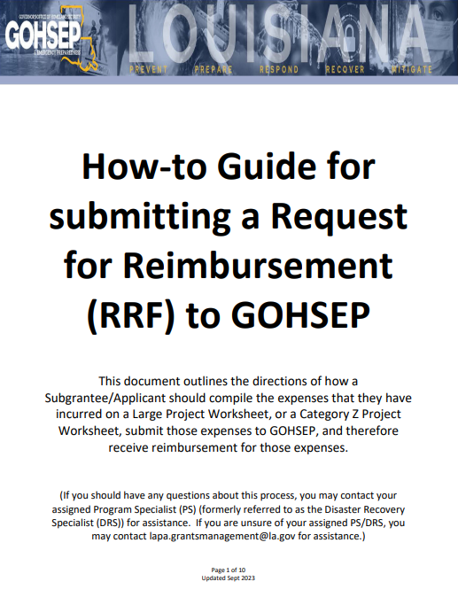
RRF Training Packet

Slide 10
Reimbursement Request Form (RRF)
The top of the Form must be filled out completely
Only the dollars for the Type of Work being requested should be entered on the Form, and totaled
The Authorized, Primary, or Alternate Agent per the Contacts of the applicable Disaster can sign and date the RRF
Signatures created with digital signature software are accepted; signature cannot be a name typed in cursive font
Use of this form is required

Slide 11
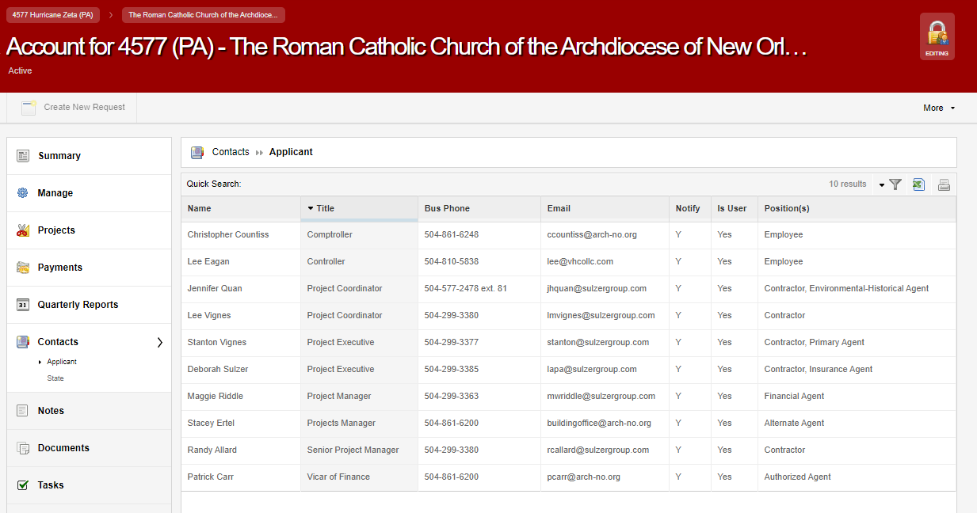
Required Signature on RRF
2- Primary Agent= Who We Should Talk to the Most
3- Alternate Agent= Who We Should Contact if Primary is Unavailable
1- Authorized Agent= “Top Dog” of the Applicant

Slide 12


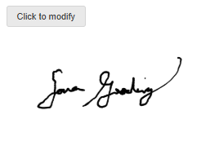
Question
Which signature type is accepted on the RRF? Select all that apply.
Y
M
Any Electronic Signature software
A handwritten signature
Signature typed in a cursive font
C
A
E-signature in LAPA
Sara Gooding

Slide 13
Question
Which of the Applicant’s contacts can sign an RRF? Select all that apply.
The Authorized Agent
The Alternate Agent
Y
M
The Primary Agent
Any contact listed in LAPA
C
A

Slide 14

Required Documentation
Items required during the reimbursement process include the following:
Reimbursement Request Form (RRF)
Summary Records
Invoices
Contracts
Evidence of Proper Procurement
Other Supporting Documentation as needed (Proofs of Payment, Subcontractor Invoices, Timesheets)
Notes:
Explain what the reimbursement request form is and that the RRF in addition to all summary records can be found under the resources tab in LouisianaPA.com which will be discussed in later slides. Stress to the audience that this is a REIMBURSEMENT Program. It is up to you to keep good records and submit your documentation to GOHSEP. You have to submit all required documentation to GOHSEP for reimbursement and retain additional documents for closeout and audits. We like to see complete and accurate packages with no returns because returns can delay reimbursements.

Slide 15
Summary Forms
FEMA has summary forms available for each work type
You can find them online on any search engine if you search for FEMA Summary Record.
You can find them on the LouisianaPA.com website. On LAPA, go to the Resources tab, then Forms & Materials
Applicants are not required to use the FEMA work type summary forms, so long as all necessary information is provided on the summary forms they choose to provide
Excel versions of summary forms, and any other backup documentation, are allowed and encouraged as they aid in review

Slide 16

Types of Work (Summary Records)
Force Account Labor
Force Account Equipment
Materials
Rented Equipment
Contract Work
Notes:
Highlight each summary record which will be detailed on subsequent slides

Slide 17
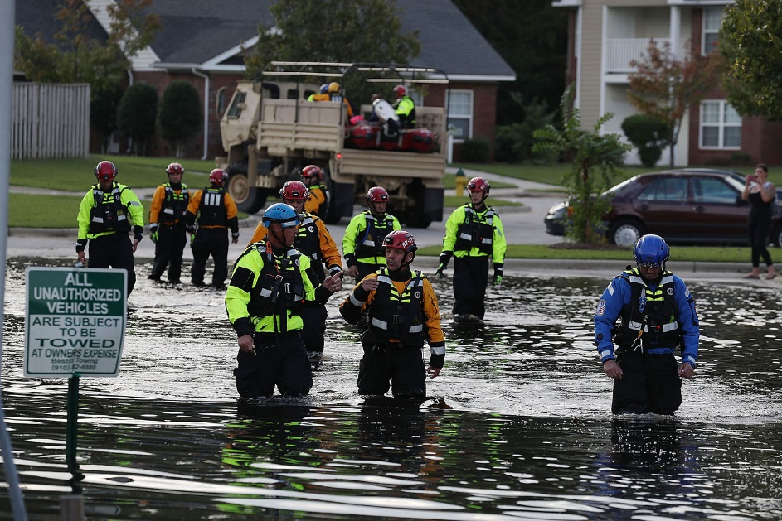
Force Account Labor
Work performed by Applicant’s own staff directly related to the disaster
Documentation needed:
Force Account Labor Summary Record listing name, job title, regular and overtime hours, total hours, rate of pay, benefit rate, and total dollars
Fringe Benefits Calculation Sheet
Pre-disaster Overtime Policy
Timesheets/Time Records and payroll documentation should be maintained by Applicant. These may be requested by Grants to validate Overtime hours, match hours to Force Account Equipment, etc... Timesheets will be requested at Closeout.
Notes:
Applicants want to capture all costs so they need to submit an accurate summary record with HOURS worked by DAY per WEEK as this is critical in determining OT worked and what hours are eligible for reimbursement.

Slide 19
Force Account Labor Summary Record
Summary Sheet must list:
Employee name
Employee job classification, job title
Hours worked (Regular and Overtime)
Total hours (daily/weekly)
Rate of Pay (base, before benefits)
Fringe Benefit Rate, if claimed
Usually seen as a dollar amount but sometimes the percentage.
Total Pay Rate (benefit rate + hourly rate)
Total Requested
Grand Total

Slide 20
Fringe Benefit Calculation
Fringe benefits on Force Account Labor are eligible for reimbursement
Applicant’s Benefits Calculation Worksheet should be completed for each employee or each type/category of employee
Because certain items in a benefit package are not dependent on hours worked, like health insurance, the fringe benefit rate will typically be higher for Regular Time hours.
Notes:
This is the Applicant’s non-wage compensation such as insurance, social security, sick and annual leave, and retirement benefits provided in addition to normal salary. The Fringe Benefits can encompass as much as 30% of a base salary package, so it is important to capture those costs for eligible employees and work too.

Slide 21

Overtime Policy
Overtime Policy:
Must be in place, in writing, at time of event
Must be consistently applied
If declared internally (not in an official organization Policy), the Applicant must provide copies of any Memos/Police Jury Minutes which enacted the overtime qualifications
Should be as detailed as possible to define terms of overtime hours and pay
Notes:
If an Applicant doesn’t have a written OT Policy, they need to start drafting one immediately!
If the Applicant does not have a written OT Policy but can demonstrate that OT has been paid in the past or that that’s how they “normally” pay OT, it will help FEMA with eligibility determination and project formulation and will help GOHSEP with reimbursement. However, this is a very tedious process so an OT Policy should be written.
Policy must be used, enforced, and applied prior to the event (Disaster)

Slide 22
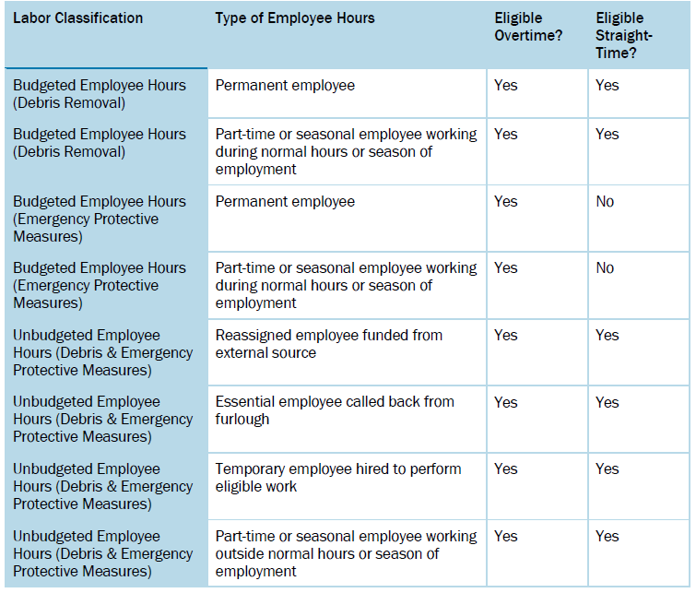
Who Gets Paid What???
Per the January 2025 PAPPG:
Category I: All overtime labor costs are eligible, straight-time costs only eligible for unbudgeted labor
Notes:
For Debris Removal (top 2 lines), text of the PAPPG still states that straight time is eligible for Cat A PWs pursuant of the Alternative Procedures for Debris Removal

Slide 23

Common Hiccups with FAL…
Labor performed beyond Work Deadline
Overtime policy not followed or not dated pre-Disaster
Incorrect math
Sick time / holiday pay / etc. and how they relate to the policy and the hours worked (example: Labor Day 2012)
No Regular Time hours listed (only Overtime shown)
Discrepancies between timesheets and the Summary Sheets (if timesheets were provided)
Requesting ineligible work, rest time, meals, breaks, or on-call time

Slide 24
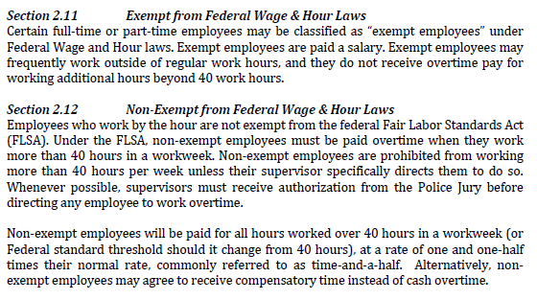
Question
Based off the overtime policy below, what information would the Applicant need to provide on the FAL Summary sheet in order to demonstrate compliance with their overtime policy?

Slide 25
Question
Based off the overtime policy below, what information would the Applicant need to provide on the FAL Summary sheet in order to demonstrate compliance with their overtime policy? Select all that Apply.
Employees’ base and overtime rates
Y
Proof of 40 regular
hours worked
M
Employee Exemption
status
C
Pay Statements
A

Slide 26
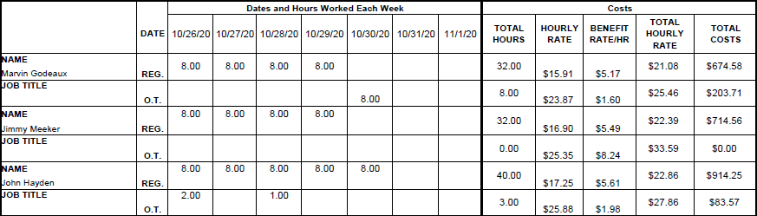
Question
Based off the overtime policy on the previous slide, what information is missing from the Applicant’s FAL summary below? Select all that apply.
Employees’ base and overtime rates
Proof of 40 regular
hours worked
Y
M
Employee Exemption
status
C

Slide 27

Force Account Equipment
Equipment owned by the Applicant and used for Disaster-related work
Documentation needed:
Force Account Equipment Summary Record listing description or type of equipment, horsepower, operator’s name, dates and hours used, total hours, equipment rates (using FEMA cost codes) and total dollars
Payroll records and usage logs to support expenses should be maintained by Applicant
Notes:
FAE Summary records will be cross referenced to the FAL Summary records during reimbursement and must “match”
Standby time is typically ineligible
FEMA Cost Codes (equipment rates) is a published schedule of equipment rates applicable on a national basis found on FEMA.gov. Generally, the lower rates of FEMA, State, or local rates will be applied to the project.

Slide 28
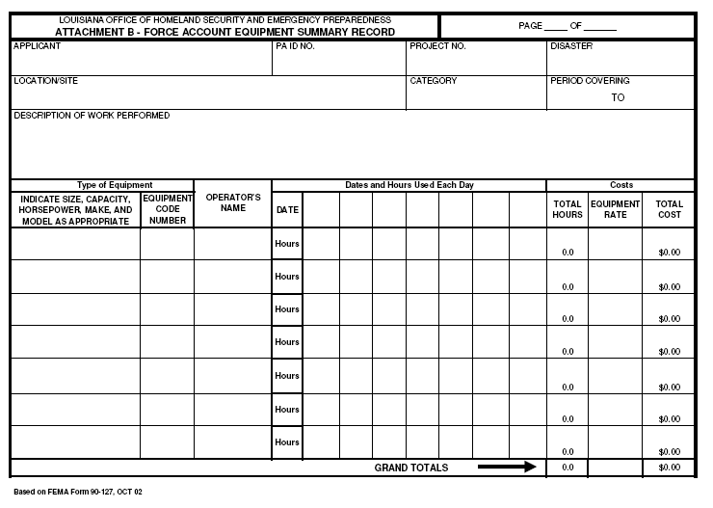

Slide 29
Force Account Equipment Summary Record
Summary Sheet must list:
Type of equipment (complete description including size, horsepower, trade name, etc)
FEMA Equipment Code (or other code)
FEMA Equipment rate (or other rate)
Equipment Operator’s Name
Dates and number of hours the equipment was used per day
Total cost to use the equipment
Grand total
Notes:
Equipment Rates typically include cost of operation, insurance, depreciation and maintenance.

Slide 30
Where to Find FEMA Equipment Rates
You can find them online on any search engine if you search for FEMA Equipment Codes.
Be sure to pull the appropriate rate sheet in effect at the time of Disaster Declaration, not when the equipment was used.
You can find them on the LouisianaPA.com website. On LAPA, go to the Resources tab, then the "Disaster Specific Info" tab, where you'll find the Equipment Rates that apply to each Disaster by clicking on the gray bar for that Disaster.

Slide 31
Other FAE Tips
FEMA Equipment Rate used should be based on date of Disaster declaration, not date work was done
FAL Summary Record may include workers who did not operate equipment or who are not reported on the FAE. (Workers could have been doing something else)
Any worker(s) reported on FAE should also be reported on FAL Summary Record.
OR be backed up by timesheets.
FAL total hours can exceed the FAE total hours; however, the FAE total hours cannot exceed the FAL total hours.*
The term ‘Various’ may only be used when referring to the operator of items that are not required to be manned at all times.

Slide 32
Common Hiccups with FAE…
Use of equipment beyond Work Deadline
Equipment size/specs not identified
Incorrect FEMA Equipment Rate used- should be based on date of Disaster declaration, not date work was done
FAE Summary including workers who were not claimed on the FAL and for whom timesheets have not been provided, or for more hours per day on FAE than was shown on the FAL or timesheets
The term “Various” being used for the Operator’s name on equipment that requires an operator
“Various” can only be used when referring to equipment such as generators, pumps, or light poles that are not required to be manned at all times while in operation

Slide 33
Question
Look at the equipment description the Applicant provided on the FAE summary below.
Both pieces of equipment are listed as: Tug Boat

Slide 34
Question
According to the FEMA schedule of rates below, what is the correct code and unit cost for the equipment description “Tug Boat”?
Y
M
C
A

Slide 35
Question
Look at the equipment description the Applicant provided on the FAE summary below.
The first piece of equipment is listed as: Tug Boat, 26ft, 250HP
The second piece of equipment is listed as: Tug Boat, 35ft, 380HP

Slide 36
Question
According to the FEMA schedule of rates below, what is the correct code and unit cost for the equipment description “Tug Boat, 26ft, 250HP”?
“Tug Boat, 35ft, 380HP”?
Y
M
C
A

Slide 37
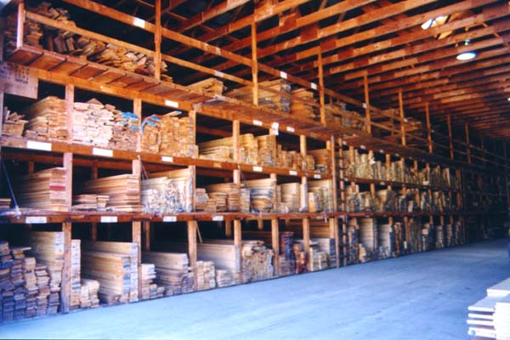
Materials
Items purchased OR pulled from inventory related to the Disaster
Documentation needed:
Material Summary Record listing vendor, description, quantity, unit price, total price, date purchased, date used
Invoices
Beginning and ending inventory log with unit price per item and structure used to determine unit price per item
Procurement information as needed
Cancelled checks and purchase orders should be maintained by Applicant
Notes:
Applicants typically provide a new receipt related to their new purchase but they could also provide the old invoice if materials were pulled from inventory along with a beginning and ending inventory.
State contracts are great to purchase from because the procurement to establish reasonable costs has been done already.

Slide 38
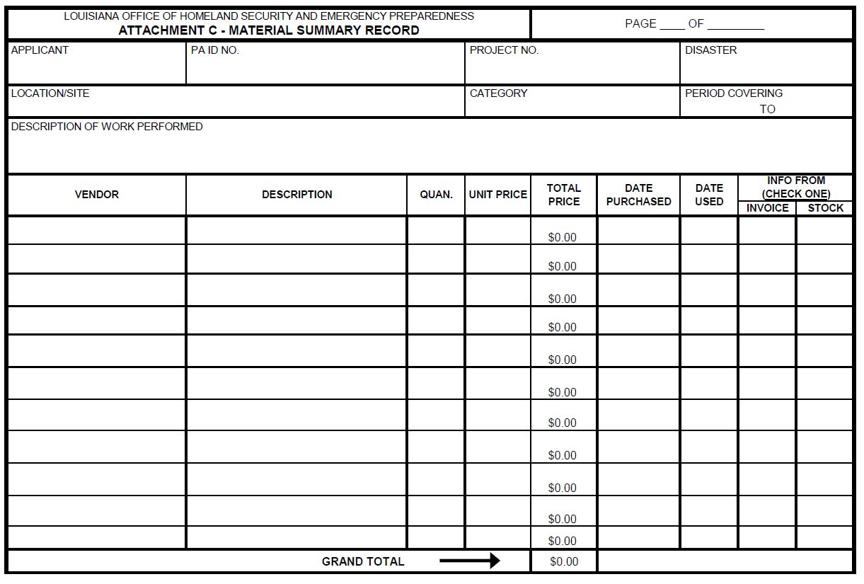
Material Summary Sheet

Slide 39
Material Summary Record
Summary Sheet must list:
Vendor Name
Invoice Number
Invoice Date/Dates Stock Used
If stock, quantity and unit price also needed
Amount requested per invoice/stock item
Grand Total

Slide 40
Common Hiccups with Materials…
Purchase of items beyond Work Deadline
Pre-storm or post-storm inventory/invoices missing for stock claims
Purchase of out-of-scope items
Taxes charged to a tax-exempt Applicant
Missing/Lacking Procurement
Sole source

Slide 41
Question
View the Applicant’s material summary below. Which of these invoices on the following slides is suitable to support the amount the Applicant has requested?
VENDOR
NAME

Slide 42
Y
M

Slide 43
C
A

Slide 44
Question
View the Applicant’s material summary below. Which of these invoices on the following slides is suitable to support the amount the Applicant has requested?
Y
M
C
A

Slide 45

Rented Equipment
Equipment rented to complete Disaster-related work
Documentation needed:
Rented Equipment Summary Record listing description or type of equipment, date and hours used, rate per hour, total cost, vendor name, invoice number
Invoices
Procurement documentation as needed
Contract/rental agreement if applicable
Notes:
This is funding for rented sump pumps, generators, tractors, chainsaws, etc…
No standby time reimbursed
Applicants can lease, purchase, or rent-to-own but FEMA will only reimburse for reasonable costs to use the equipment and will deduct salvage value. This equipment still has a useable shelf life that Applicants may benefit from in the future.

Slide 46
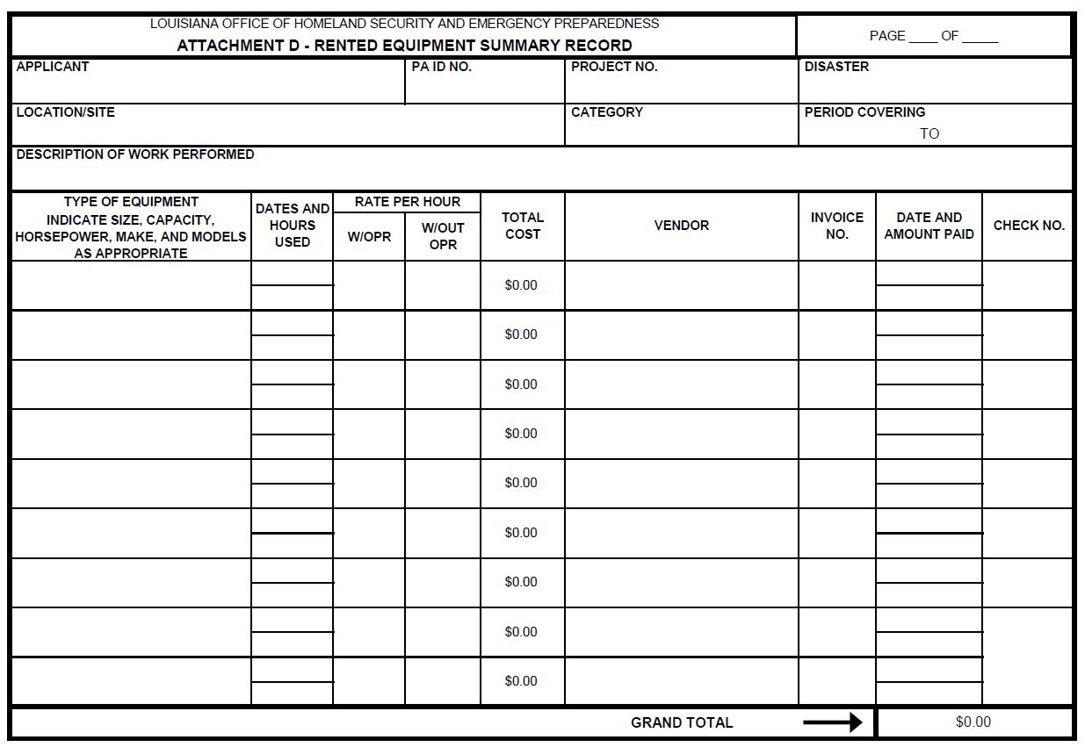
Rented Equipment Summary Sheet

Slide 47
Rented Equipment Summary Record
Summary Sheet must list:
Vendor Name
Invoice Number
Invoice Date
Amount requested per invoice
Grand Total

Slide 48
Common Hiccups with Rented Equip…
Rental of items beyond Work Deadline
Rental of out-of-scope items
Missing rental agreement/contract
Charges for Warranties or Rental Protection included in requested amount
Missing / Lacking Procurement
Sole source

Slide 49

Contract Work
Work performed by contracted labor directly related to the Disaster
Documentation needed:
Contract Work Summary Record listing date, contractor, invoice number and amount of invoice
Invoices (signed by Contractor and A&E firm when appropriate)
Procurement information (requests for bids, copy of advertisement soliciting bids, bids from at least three vendors or bid tab)
Written Agreement
Ensure that costs are reasonable and are competitively bid
Avoid debarred or suspended contractors
Notes:
Stress reasonable costs and will need procurement evidence and signed contracts
Applicant should have their attorneys review every contract before it is signed and entered into

Slide 50
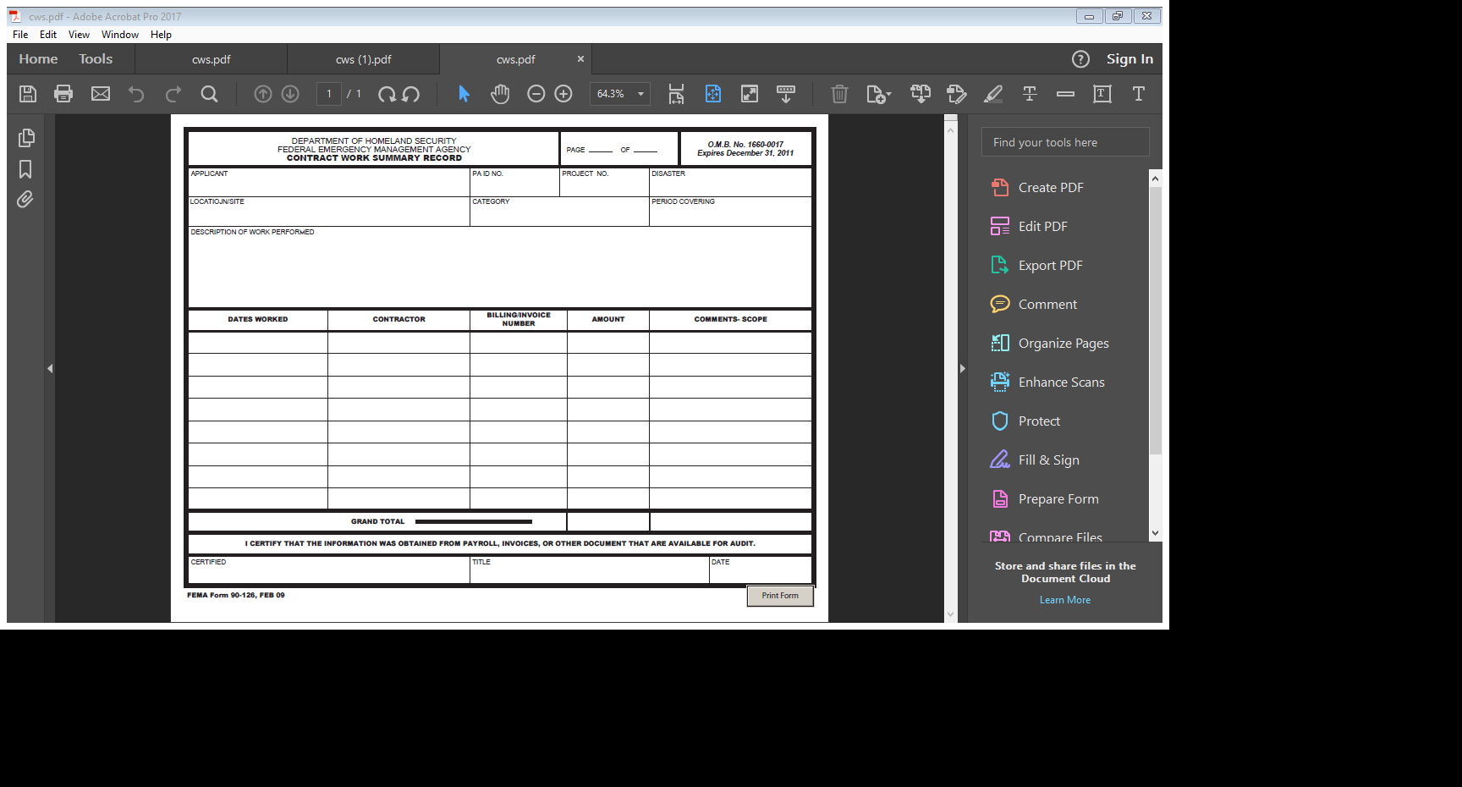
Contract Work Summary Record

Slide 51
Contract Work Summary Record
Summary Sheet must list:
Vendor name
Invoice number
Invoice date
Amount requested per invoice
Grand Total

Slide 52
Contract Types
Accepted Contract Types
Lump Sum
Unit Price
Cost-Plus Fixed Fee
Sole-Source
Time and Materials (with or w/o ceiling)
Unaccepted Contract Types
Cost-Plus Percentage of Cost
Piggyback
Contingency

Slide 53
Contract Provisions
44 CFR 13.36(h)(3)(i) and Title 2 of the Code of Federal Regulations (2CFR) contain language requiring that certain provisions/clauses are included in contracts that will be reimbursed through Federal funding.
Familiar Examples:
Clean Air and Water Pollution Control Act
Equal Employment Opportunity
Debarment and Suspension
Termination for Cause or Convenience

Slide 54
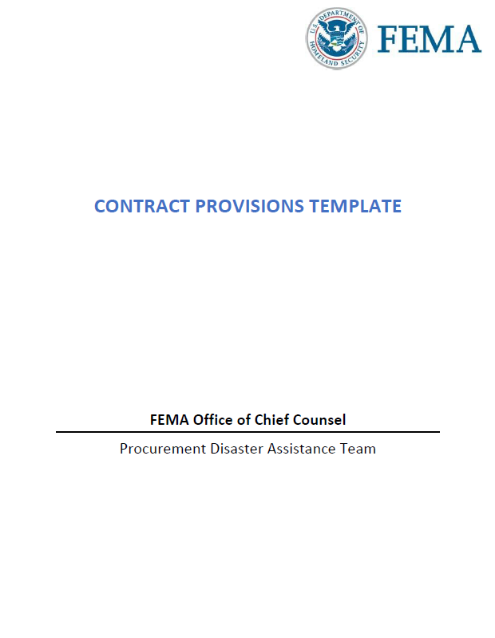
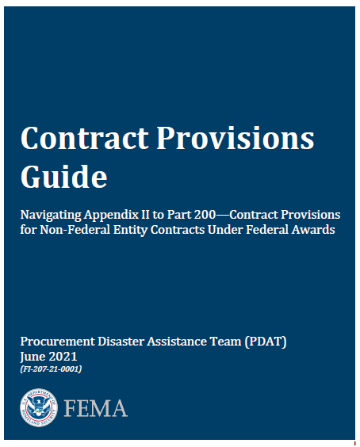
FEMA’s Contract Provisions Template and FEMA’s Contract Provisions Guide (PDAT)
DR-1603 to DR-4570
Pre Nov 11 2020
DR-4577 to Present
Post Nov 11 2020

Slide 55
Common Hiccups on Contract Work…
Work performed beyond Work Deadline
Proper Procurement not followed and/or Cost Reasonableness not demonstrated
Contracts not including the applicable contract provisions
Previous Invoices/Pay Applications not demonstrating continuance of cost
Requesting reimbursement on Change Orders that have not been obligated by FEMA in the PW scope of work

Slide 56
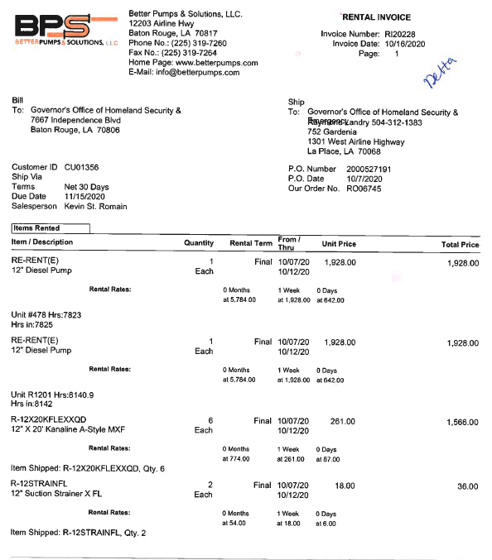
Question
The Applicant is claiming that the items listed on this invoice were purchased off of a state contract.
Items Billed:
12” Diesel pump, $1,928
12”x20” Kanaline A-Style MXF, $261
12” Suction Strainer x FL, $18

Slide 57
Question
Compare the items billed on the invoice to the excerpt of the State Contract rate sheet below. According to the information provided, which of the invoiced rates are supported by the State Contract? Select all that Apply
Items Billed:
12” Diesel pump, $1,928
12”x20” Kanaline A-Style MXF, $261
12” Suction Strainer x FL, $18
Y
M
C

Slide 58
Question
The Applicant has submitted the Contract Work Summary below. Review the Cost Validation Summary (CVS) on the next slide to determine which, if any, of these costs are considered to be in scope.

Slide 59
Question
Cost Validation Summary Totals page

Slide 60
Question
According to the CVS, which, of these costs are considered to be in scope. Select all that apply.
Y
M
C

Slide 61
What is….. Procurement?
The acquisition of goods, services or works from an external source. It is favorable that the goods, services or works are appropriate and that they are procured at the best possible cost to meet the needs of the purchaser in terms of quality, quantity, time, and location
Generally costs are reimbursed based on the lowest bid

Slide 62
Procurement
Four (4) Methods Accepted by FEMA (44 CFR § 13.36)
Small Purchase Procedures
Items less than $250,000
Proper procurement policies vary depending on category of purchase
Sealed Bids (formal advertising)
Preferred method for construction contracts
Competitive Proposals
Often used for procuring architectural or engineering professional services
Non-Competitive Proposals
Proposal received form only one source; requires cost analysis
All contract procurement for Emergency and Permanent work should be conducted in a manner providing full and open competition
How many bids are actually needed to prove Procurement / cost reasonableness?
Only 2 are required, 3+ are preferred
Notes:
Explain in general terms each one of the 4 accepted methods: 1) informal method for securing goods or services 2) advertised and awarded to lowest responsive and responsible bidder 3) similar to sealed bid in which contracts are awarded on basis of qualifications instead of solely on price 4) requires cost analysis in this type
PNP’s under general circumstances do not have to follow Louisiana Public Law but when using Federal funds they still must follow 44CFR similarly to all other applicants (state and local govt’s).
Evidence of proper procurement procedures for both emergency and permanent work must be provided.
Follow stricter bid law whether Federal, State, or local
From our Grants Management perspective, we look for an attempt to secure the lowest bidder.
Regarding the number of bids required to prove procurement/cost reasonableness: Per 44CFR 13.36(d)(1). (FEMA has interpreted this as THREE sources. Christen found that in the “Public Assistance Grantee and Subgrantee Procurement Requirements Under 44 C.F.R. Pt. 13 and 2 C.F.R. Pt. 215 FEMA Office of Chief Counsel Procurement Disaster Assistance Team December 2014 Field Manual”, although it certainly could exist in other documents too.) But, GOHSEP has interpreted this as 2 sources since the early days of DR-1603 and FEMA has never questioned it.

Slide 63
Procurement
Any work that is not supported by proper procurement must be proven cost reasonable in order to be reimbursed.
This includes instances where the Applicant is claiming the use of Emergency Procurement procedures
Any Work that was properly procured but where only one responsive and/or responsible bid was received still needs to go through the proper procurement process to be proven Cost Reasonable.
If the procurement method used does not provide adequate price comparisons to demonstrate cost reasonableness, a Cost Analysis will be needed.

Slide 64
Management Costs (Cat Z)
Can also be called Interim Management Costs Policy or Disaster Recovery Reform Act of 2018 (DRRA)
Applies from August 1, 2017 to present
Use of Management Cost Funds
Activities eligible as management costs include those related to developing eligible PA projects and receiving reimbursement. This may include, but is not limited to:
PDAs
Meetings regarding the PA Program (Recovery Scoping Meeting)
Site Inspections
Travel Expenses
Reviewing PWs
Requesting disbursement of PW funds

Slide 65
Management Costs (Cat Z)
5% of post-reduction obligated costs
There will be one separate Category Z PW
Are funded at 100% Cost Share
Project is treated as a Large Project regardless of obligated amount
RRFs will have to be submitted, with supporting documentation!
Applicant can only be reimbursed actual cost incurred, up to the obligated amount; excess funds cannot be retained
Documentation requirements are dependent upon work type, but also require task descriptions for any Force Account Labor and Contract Labor costs
Both Indirect and Direct Costs can be documented

Slide 66
Time Limits/Time Extensions, Cat Z
Category Z PWs work completion date is calculated differently. A Cat Z PW’s Work Deadline date is whichever of the following occurs first:
180 days after the Applicant completes its last non-management cost PA project
180 days after the latest performance period of the Applicant’s non-management cost PA projects
Two years from the date of an Emergency Declaration
Eight years from the date of a Major Disaster Declaration
Time Extension requests can be submitted, but are not typically processed
Request should include the project number, a justification of the need for the extension, supporting documentation, and a proposed date for completion.

Slide 67
Question
Which of the following does not describe a Category Z Management task?
Y
Collected and organized damage photos
M
Travel costs for PW 2056 site inspection
Compiled invoices to submit on
PW 75 RRF 4
Met with A/E to discuss additional survey and
permitting requirements
C
A

Slide 68
Express Pay System (EPS)
What is the Express Pay System?
A voluntary program that GOHSEP made available to Applicants in 2008 through which GOHSEP reimburses an Applicant very quickly for costs that they have incurred on a Large Project after only a Cursory Review of the submitted documentation, so as to keep the Applicant’s recovery funding flowing.
90% of the RRF is paid through the EPS payment; the remaining 10% is held as retainage and is released, if owed, upon approval of the RRF
Large Projects only!
Notes:
EPS started in March 2008. Prior to then, only the traditional Detailed Expense Review was available.
The EPS process does not apply to Small Projects.

Slide 69
Express Pay System (EPS)
Why would an Applicant want to enroll in the Express Pay System?
They can receive funding from GOHSEP that they’ve requested within 10-14 business days of their submission of a good request
Notes:
Average time to payment is really 4-5 days, although it’s promised within 10-14 days.

Slide 70
Express Pay System (EPS)
Applicant uploads Expenses into LAPA, ultimately submitting Reimbursement Request Forms (RRFs) into LAPA
RRFs appear in the Cursory Review queue in LAPA
PS performs a “Cursory Review” of the submitted Expenses to determine if an Express Pay payment can be issued
If the RRF passes Cursory Review, PS moves the RRF to the Preparer queue, while triggering an Express Pay payment
PS does Detailed Expense Review after EPS Payment has been made
The amount withheld from the EPS Payment will be paid (if warranted) after the Detailed Expense Review has concluded, or funds will be collected (if warranted).

Slide 71
Question
FEMA has obligated this PW at $1,000,000. The Applicant has submitted an RRF for $1,000,000. What is the maximum potential Express payment the Applicant could receive for this RRF?
75% - $750,000
80% - $800,000
Y
M
90% - $900,000
100% - $1,000,000
C
A

Slide 72
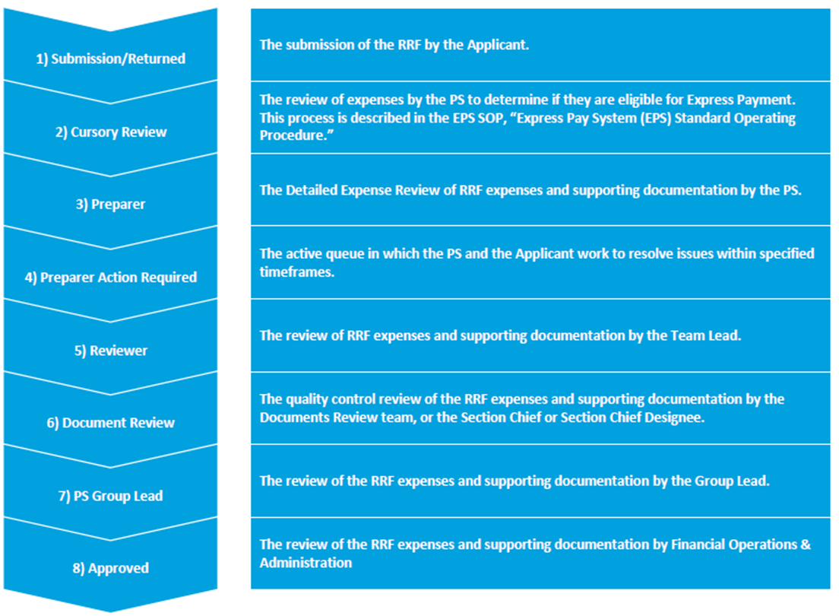
The Express Pay Process and Detailed Review Process
RRF is created by Applicant, and PS completes Cursory Review.
PS performs their full Detailed Expense Review of the RRF.
RRF is reviewed through all other Detailed Expense Review steps.
RRF is Approved and the Approved Amount is paid, if due.

Slide 73

Record Retention
Applicants must retain documentation for at least 3 years following Disaster, Applicant, or PW Closeout*
*Depending upon Disaster and guidance in place at that time.
All documentation pertaining to a specific project should be filed with that Project Worksheet, examples:
Invoices
Contracts
Proofs of Payment
Insurance Information
Electronic files are OK
Notes:
Closeout could take years so that means the documentation will need to be retained for years (Katrina, Rita, Isaac, etc), and note that in some cases FEMA requires records be maintained for 3 years after the ENTIRE DISASTER is closed…all PWs, all Applicants, and the entire Disaster. That could be 20+ years (Katrina still isn’t Closed, for example)!!
Records should describe in detail the who, what, when, where, why, and how much for each item related to a project
Everything that pertains to a project should be filed with the corresponding PW: photos, new insurance or insurance settlement info, cancelled checks, payroll records, purchase orders, maintenance records, reimbursement documents (RRF, summary records, invoices, contracts, procurement info)
Retention period starts after an Applicant receives notification that all of their PWs, a specific PW, or the Disaster has been closed.
Records Retention= 2CFR 200.334 and 200.337

Slide 74
Helpful Emails for GOHSEP
LA.PA@LA.Gov – LouisianaPA.com questions or issues
RPA.Help@LA.Gov – RPA questions or issues
MOU.Help@LA.Gov – MOU questions or issues
LAPA.GrantsManagement@LA.Gov – EPS Opt-Ins, general reimbursement questions
LapaInsurance@LA.Gov – Insurance questions or issues
Debris.Help@LA.Gov – Debris questions or issues
GOHSEPlegal@LA.Gov – Legal, appeals questions, public information requests
PASALS@LA.Gov –SAL, versions, version requests questions or issues
PACloseout@la.gov- Closeout questions or issues
Notes:
Soon to be created: GOHSEPPA@LA.Gov – General Public Assistance questions

Slide 75
Thank You!

